Slide 1
Talk | Title | Time Period | Date of Talk
8 | The early Republic | 1792-1800 | October 30th
9 | Jefferson’s America | 1800-1808 | November 6th
10 | War of 1812 and its impact | 1808-1815 | November 20th
11 | The Era of Good Feelings | 1816-1828 | December 4th
12 | Jacksonian ‘democracy’ | 1828-1840 | January 15th
13 | New Spain, Mexico and the Texas Republic | 1820-1836 | January 29th
14 | Continental Superpower | 1840 -1850 | February 5th
14 | California Gold Rush and its impact | 1700-1850 | February 19th

Slide 2
American History
1
Talk 14: A Continental Superpower created
(1836-1850)

Slide 3
Overview
Panic of 1837
Rise of the ‘Whigs’
Manifest Destiny
Election of 1844
Annexation of Oregon
Annexation of Texas and Mexican War
The Continental Superpower

Slide 4
Panic of 1837

Slide 5
Leadership Change
Jackson retires at end of Second Term in 1836
Booming land prices and speculation not Jackson’s idea of America
Issues “Species Circular” : all US land sales to be made in gold (not paper money or loans)
Picks Martin Van Buren to be his replacement (VP and campaign manager)
Opposition Party “National Republicans” in chaos… field 4 candidates!
Van Buren winds landslide and takes office March 1841
Panic of 1837 begins

Slide 6
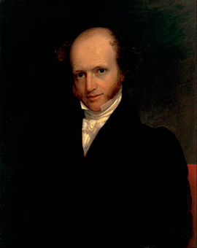
Martin Van Buren (1782-1862)
Born to Dutch family New York..
Only President with English 2nd language
At aged 48 (1830)
Lawyer turned professional Politician…and deal maker and opportunist
….Abolitionism a threat to the Union …..Political Parties offset North /South split
A President famous for nothing
Rejects annexation of Texas to avoid war
war with Mexico,
Rejects government intervention to help
for poor or improving economy
…Free market will correct
“The happiest days of my life that of
Entering office and that of leaving it”

Slide 7
The Panic of 1837
Underlying Causes:
30 million acres of Indian Land available for sale by government
US pays off national debt…surplus distributed to Pet Banks …surge in lending
Land, cotton, slave price boom
Surge in lending based on future prices…including ‘slave mortgages’
Removal of regulation: Bank of USA dissolved and 300 new banks created
Triggers:
Reduction gold supply: Britain increases interest rates …fears of US over-speculation + war in Mexico reduces production
Increase gold demand: Jackson “Specie Circular”…all land sales in gold only
Oversupply of cotton due to bumper crops US, Egypt, and British India Price of …….cotton falls 25% in march 1836

Slide 8
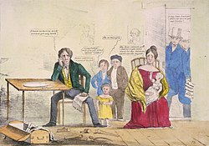
The Panic
Out of 850 banks in US, 340 close
65 partially default as paper notes
Became worthless.. investors
Panic….no deposit insurance
Land prices crash (example
Michigan & Indiana)from $10 to
$3 per acre,
Money supply shrinks 30%
Northern manufactures and
Southern Plantation Owners most
effected. Creditors call in loans,
Debtors go to prison….or Texas
Panic as deep as that of 1819 and
Lasts longer….from 1837-1845

Slide 9
Impact Panic of 1837-1845
Starvation avoided due to agricultural economy…extensive malnutrition
…….children ‘shrink’ 5 cm across northern industrialising areas
Financial power consolidates in New York as weaker state banks flounder, and Florida, Arkansas and Mississippi repudiate debt
Slaves ‘sold south’ to fund debts
… 250,000 sold between 1837-1839 vs 1 million 1820-1860…families separated
…Virginia and ‘border’ states focus on breeding slaves for resale
Population of Texas soars…(no extradition treaty)

Slide 10
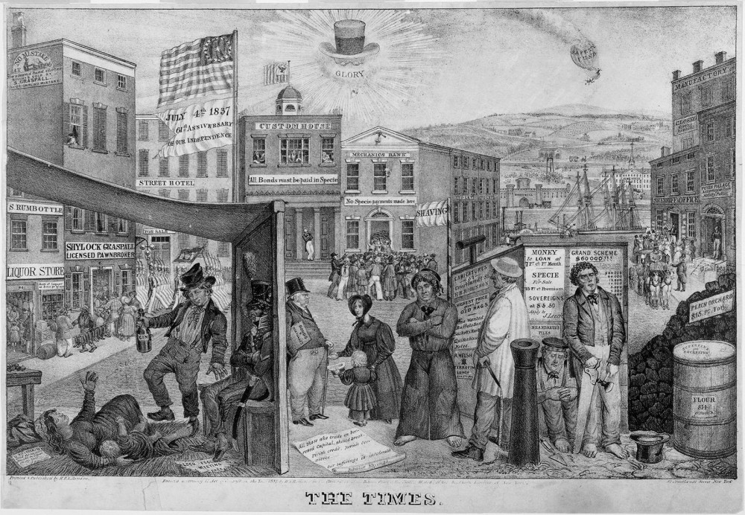
Political Impact
Jackson…shining in glory
…while country goes to hell
Van Buren “Van Ruin”
Democrat Republicans
Discredited ‘Agricultural
Empire’ of yeoman farmers
shattered
National Republicans
‘rebranded’ as The Whigs ..pro industry
High tariffs &Improvement,
Two party system back

Slide 11
Rise of the “Whigs”

Slide 12
The ‘Whigs’
Named after British anti monarchists of Revolution of 1688…Jackson the despot
Membership: Educated, former ‘Federalists; Northern and Western businessmen, Protestant evangelicals, Non slave owning Middle Class, ‘
Policies
Free market internally, high tariffs externally
Strong central Government….National Improvements, Central Bank
Fair treatment to Indians, slavery to be ‘gradual abolished”, slaves to be ‘repatriated’
Retain “British Protestantism”…oppose Catholic immigration
Want to appeal to the “Common (white Protestant) Man” and South:
………war hero ‘Westerner” for President , Virginia plantation owner for Vice President

Slide 13
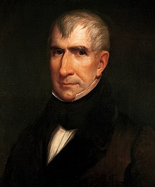
William Harrison (1773-1841)
Born to wealthy Virginia plantation.. Runs plantation and owns slaves.. Becomes Governor of North West Profits from “purchase” of Indian Lands”
William Harrison in 1835
‘Victor’ of Battle of Tippecanoe and Thames 1812
Leaves army to seek office..’celebrity over duty”
Ambassador to Colombia….lectures Bolivar (leading
Armies of Independence vs Spain ) about liberty…Bolivar
“The United States seems destined by providence to
plague America with torments in the name of freedom",
Returns to U.S moves to Ohio: Moralist but owns distillery, Support ‘ gradual abolition” but continues to trade slaves, befriends former slave running “Underground Railway.., brings them to “free state” Ohio as ‘indentured servants”
Whigs rebrand Harrison as the “Common Man”

Slide 14
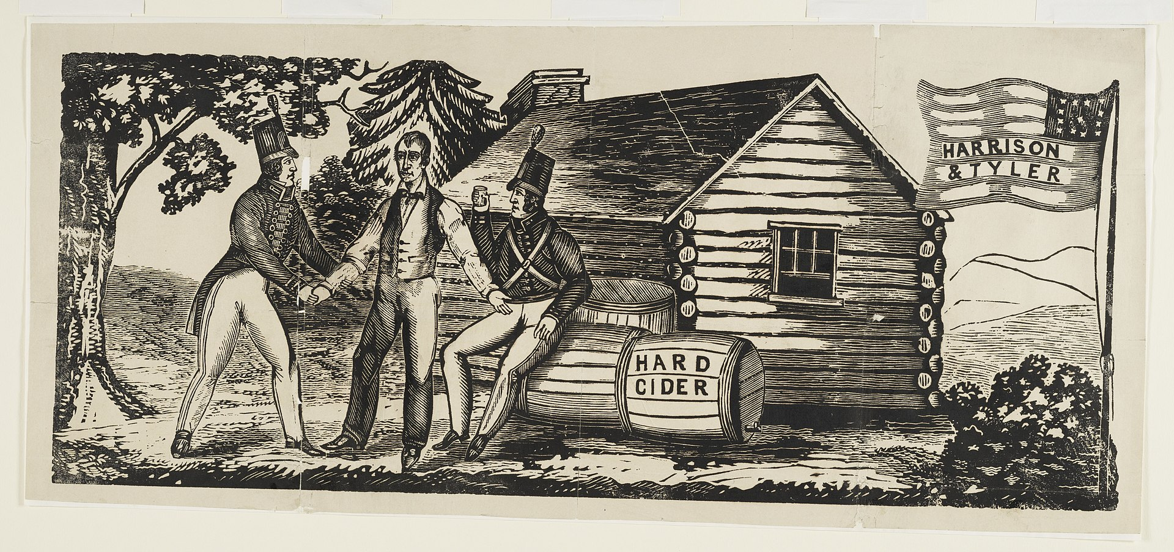
1840 Election Campaign
Harrison: ‘log cabin’ and cider
Democrats label Harrison a “drunk” provincial sitting in a log cabin drinking Hard Cider
Whigs “ Yes…..Harrison a hard drinking hero ….“Tippecanoe and Tyler too”
Avoids discussing Panic
….personality politics
Whig campaign chant:
“Old Tip he wore a homespun coat,
he had no ruffled shirt: wirt-wirt, But Matt he has the golden plate,
and he's a little squirt: wirt-wirt!”

Slide 15
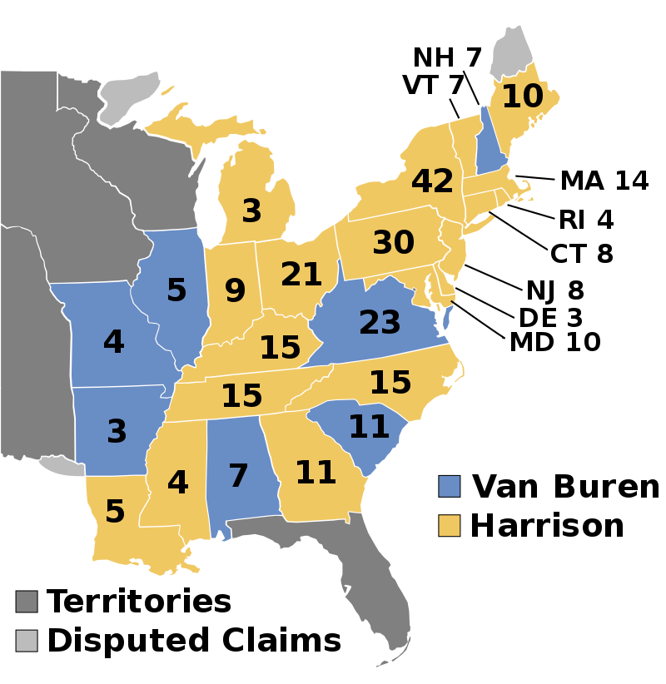
The Election of 1840
Strategy works…regional split broken
Whigs win landslide 234 electoral vote to 60, 53% popular vote
Congress Split : Whigs
Win House Democrats
Hold Senate
Harrison seeks to prove
competence.. Delivers
3 hour speech to prove
He is a man of learning
……….Gets ill and dies

Slide 16
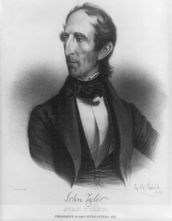
His “Accidency”: Presidency of John Tyler 1840-1844
Vice President John Tyler replaces Harrison
President John Tyler (1790-1862)
’Whig’ in name only…another Slave owning
Virginian…picked to balance ticket..
When asked why no one knew his views:
…”no one asked him what they were..”
Abandons Whig Agenda…seeks to re join
Democrats and expanding US and slave
economy
Agrees Canadian border along 49th parallel
Sends land expedition to assess California
Prospects, fleet to Pacific to threaten British
Agrees Texas can join US as slave States’

Slide 17
Manifest Destiny

Slide 18
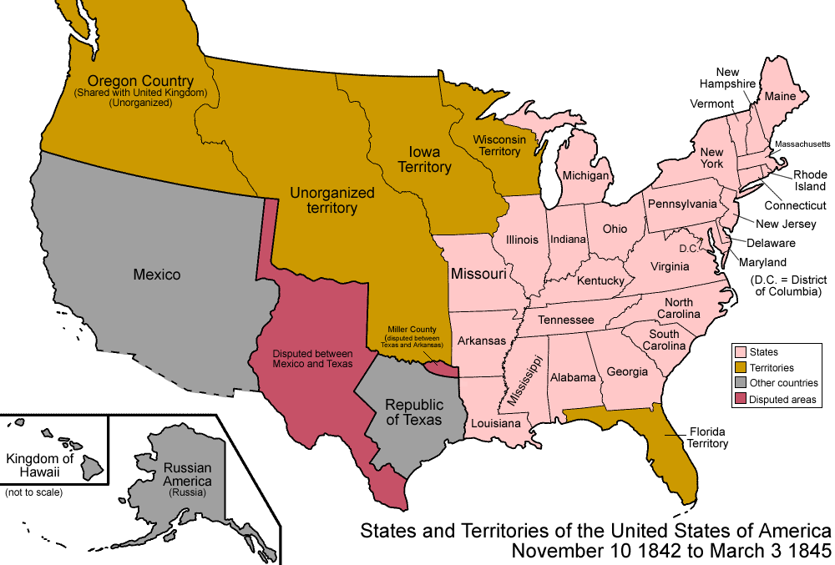
North America 1845
1. Russians ‘occupy’
Alaska …500 settlers
Only by 1850’s
3
Border Agreed
2. Territories, part of
USA but not yet states
4
2
3.Canada Border
Agreed (1842)
“Louisiana Purchase” 1803
4.“Shared sovereignty
Oregon Territory with
Britain
6
5..Texas annexed 1845..Mexico does not recognise and border disputed
5
6..Mexican West
California, New Mexico)
Lightly Populated
….open for taking…..
1
Florida
1819
2

Slide 19
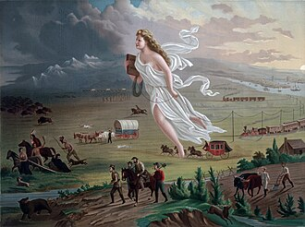
Manifest Destiny
“Manifest” ---self evident
“Destiny”…inevitable, hand of God
( John Ghast 1874)
Origin: Puritan “House on a Hill” .
Washington Jefferson”Hand of Providence”, Jackson: Destiny
Of American White Men
Book of
knowledge
No room
For Indians
Manifest Destiny…..1845 version
The superiority of the White Race
and its Institutions (2) Western North
America to be made like East
(3) Americans have a duty to God
to make use of his bounty
“Whigs” oppose. What matters
is work and money

Slide 20
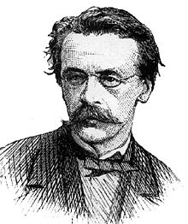
Manifest Destiny implications
“And that claim is by the right of our manifest destiny to overspread and to possess the whole of the continent which Providence has given us for the development of the great experiment of liberty and federated self-government entrusted to us.[
John Sullivan (1813-1895)
Two Competing ‘destinies’
North: Expansion to support economic growth across Continent.. provide opportunity to start new life and make room for Irish and German immigration
South: Expand slavery across North American Continent (Canada, all of Mexico)….(and some) : Cuba and Central America…even Latin America
Election of 1844 about Manifest Destiny
And what it means….

Slide 21
1844 Election : The prequel
Texas approaching bankruptcy due to ‘wars with Mexico
.Sam Houston President wants annexation
Tyler presents bill to Annex Texas as a ‘slave state’
Whig controlled Senate rejects treaty as Henry Clay claims
Democrats trying to extend power of Slave States
Tyler tries to re join Democrats…but dumped. Jackson (in retirement)
Consider Tyler ‘soft’ …supports radical expansionist James Polk

Slide 22
Election of 1844

Slide 23
The Candidates and campaign
Whigs Henry Clay: Secure wealth through industry
Bring back high tariffs, improvements, restrict slavery, bring back the Central Bank, protect Indians, restrict immigration
Democrats: uneducated, ‘common’ slave owners
James Polk: Deliver Manifest Destiny
Annex Texas..and ‘disputed territory; war with Mexico okay
Welcome white immigrants to increase population
Take All of Oregon Country…war with Britain okay
Whigs…elite, 'British’…Clay debauched hypocrite, abolitionist
and slave owner … fathering his own slaves!

Slide 24
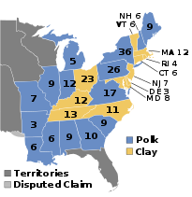
Manifest Destiny Wins….
Closest election to date
Polk win 170 electoral votes to 101
But only 1% more of popular vote
Very high turn out…popular vote
expands to 3 million votes
Polk takes all lower South and New
York by only 5,000 votes…wide spread fraud
fraud claimed…by both sides

Slide 25
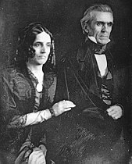
James Polk(1795-1849)
James and Jessica Polk 1845
Born in log cabin North Carolina
…father surveyor and slave holder
Moves family west to Tennessee
Attends university, learns law from attorney…becomes slave holder …elected to Congress, then
Governor Tennessee
Jackson supporter. Manifest Destiny
Objectives: Annex Oregon and all
Texas…. California and all West
America’s most successful…and
Least known president

Slide 26
Intermission

Slide 27
Annexation of Oregon Territory

Slide 28
Thickly wooded mountains and hills

Slide 29
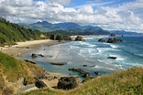
Thickly wooded coastline

Slide 30
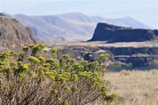
High Desert Country

Slide 31
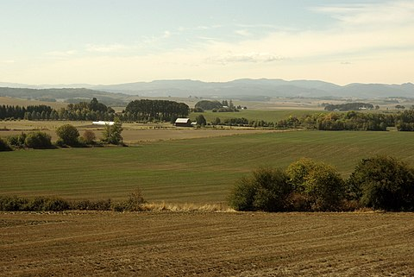
Williamhette Valley: fertile, water, perfect agriculture

Slide 32
North West Indigenous Peoples
Many disunited tribes and cultures
Inland …nomadic hunter gathers inland….e.g. Nez Perce
Coastal…complex highly structured fishing and agriculture settled communities …elaborate rituals, exquisite, canoes, totem poles and art, practice slavery
Peaceful coexistence with early settlers…despite rough start (Tonquin incident)
first arrivals fur trappers
Trade regulated by British Hudson Bay Company..
Trade, not agriculture
Disease reduces population from 200,000 to 10,000-20,000 before settlers begin arriving In 1840’s’…

Slide 33
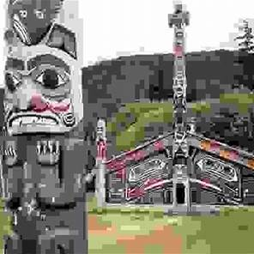
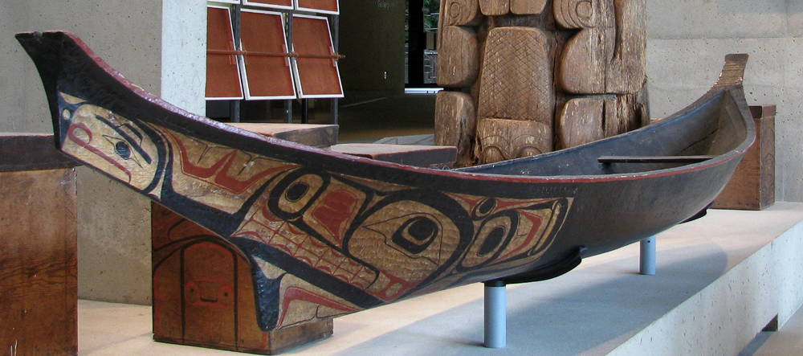
Chinook Tribe Coastal: highly stratified from Chiefs to slaves, ancestor worship, communal halls, canoes for coastal trade

Slide 34
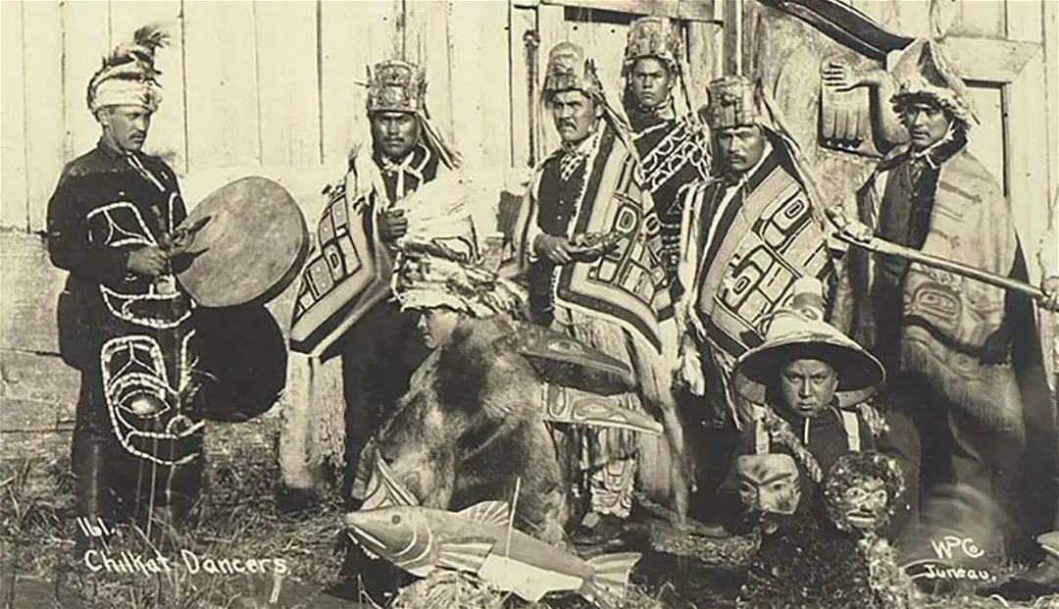
Elaborate costumes, emphasis on ceremony …………communal gift giving (Potlach)

Slide 35
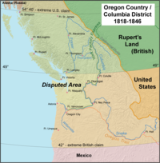
The Dispute with Britain
‘54/40 or “Fight”
Shared occupation British Hudson
Bay Company and American settlers
1800-1840
Farming communities arrive 1830’s
15,000 settlers by 1845…
Agreed Boundary
Polk “54/40’or fight…election slogan
Threatens war…..but this a gambit
British invite Americans to divide
region…want 49th parallel extension of 49th
Oregon Treaty Agreed 1846…
Polk fears war with Britain, not
Mexico does not want two wars!

Slide 36
Annexation of Texas …and war

Slide 37
Preliminaries
Texas 1845
Bankrupted by wars in Mexico & Comanche
Population rising rapidly from 50,000 at Independence from Mexico to more than 200,000
Slavery core to economy, 50,000 slaves by 1850
Negotiations
Seek treaty with Mexico, Britain as mediator.. No agreement on border
Britain demands emancipation of slaves as condition for Treaty
Tyler and Southern Democrats want Texas annexed as 4 states, 3 ‘slave’. Northern States demand 2 states, one ‘free’, one ‘slave;
Calhoun spreads rumour British seeking to acquire Texas

Slide 38
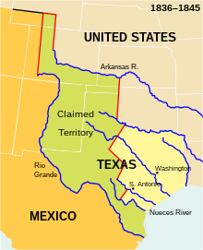
Declaration of war
New President Polk wants
Unconditional annexation by Texas
….after agreeing Oregon Treaty
Texas border
Per US
Offers to ‘buy’ California’ from
Mexican government …rejected
Polk”…secures Senate approval
for one state. borders to be agreed
Texas border
Per Mexico
Deploys regular army to Texas
Then a company to disputed
Territory to goad Mexican attack
Mexico
‘attacks’ US
invaders

Slide 39
US Mexican War

Slide 40
Mexico 1845
Population 7.8 million (flat since 1800) vs 23 million USA (1850)
5 different Presidents 1845-1847…Army in/out of power
Ongoing wars of Independence in Yucatan and Cahuilla
1847 ‘Polkos’ rebellion by Catholics & Conservatives vs Liberals
Northern Mexico ravaged by Comanche (supported by Texas) and undefended…..US Army welcomed by inhabitants

Slide 41
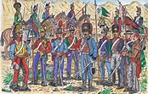
Mexican Army
Nominal Strength 80,0000
Social gap cavalry/infantry
State close to bankruptcy
antique muskets
No mobile artillery
soldiers not paid
Lucas Alaman: “money spent
on arming Mexican troops
merely enabled them to fight
each other and 'give the
illusion' that the country
possessed an army for its
defence."[

Slide 42
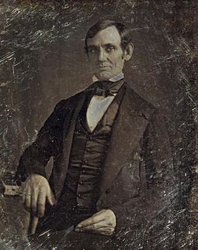
Outbreak of ‘War Fever’
Abraham Lincoln in 1845
Abraham Lincoln. Illinois
Lawyer…house of representatives
“Spot Resolution”challenges Polk
John Q Adams (fmr President)
…”unjust and unholy war”
Attempt by South to expand slave
empire
‘War fever’ takes hold:
Media embellish Mexican “attack
& spread rumour British eyes
about to invade California

Slide 43
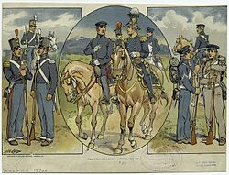
US Army 1846
Regular professional army
8,000 but well trained.
Junior officers West Point
Most infantry armed with modern rifles Highly trained mobile artillery.
Regular army increased to
30,000 plus 60,000 volunteers
50% newly arrived immigrants
Mostly from Ireland
Irish face discrimination
Hundreds desert to join Mexico
..St Patricks Regiment.

Slide 44
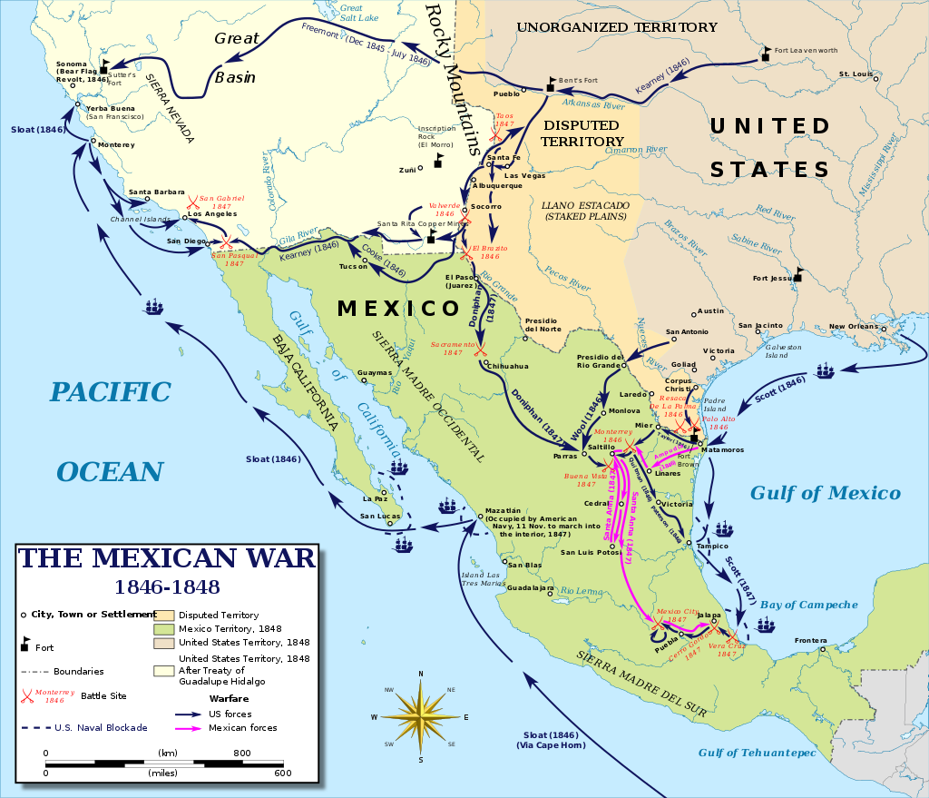
3 US Invasions of Mexico
1
1…Land and Ocean ….from West
2
2…North…Texas
3
3…Gulf Invasion

Slide 45
Invasion of the West

Slide 46
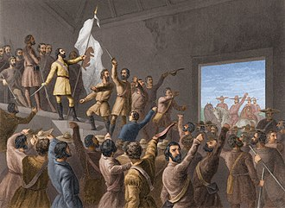
“Bear Flag Republic”
Total population California 1846
10,000 Californios (most in south)
1,500 Anglos (most in north)
150,000 Indians..no Mexican army
US Survey expedition of 60 men
arrives in north…rumour of war..
Join 30 Anglo settlers to claim
“Bear Flag Republic” June 1846
..Governor flees south
US Pacific fleet arrives August… moves south
US occupies Los Angeles
…gets drunk. Chased
Out of town by Californios
US Army moving West from
Texas arrives in force

Slide 47
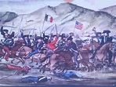
Invasion of New Mexico & California
Battle of San Pasqual December 1846
US Army invade New Mexico
July …Mexican army retreats.
Pueblo Indians revolt but crushed
…100’s killed
Army enters California …
Californio volunteer attack
…Americans lose 40 men
and retreat
Reinforcements arrive…….
Californios flee.. Americans
advance to Los Angeles

Slide 48
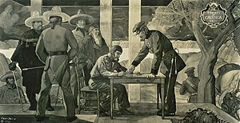
Treaty of Cahuenga January 1847
Fleet returns with army … attack Los Angeles “Battle of the Old Woman’s Gun”
…retreat
American sea and land armies
Merge 500+ men
Californios surrender
..Governor Pico surrenders
All South West is now
US America territory

Slide 49
Invasion of the North

Slide 50
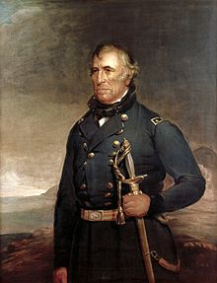
General Zachary Taylor (1784-1850)
Home tutored career soldier
…practical Soldier 'soldier
….barely literate but capable
Veteran war of 1812, Indian wars
“Old Rough and Ready”
Commands 6.500 strong Army of
Texas….sent to invade North Texas

Slide 51
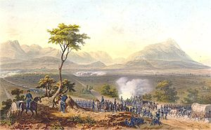
Invasion from the North
Battle of Monterrey September 21-24 1846
First major battle
6,500 US vs 7,000
Mexicans
Mobile artillery breaks
Mexican army….
Americans advance
street to street fighting
Americans win city
Mexican retreat
400 casualties each

Slide 52
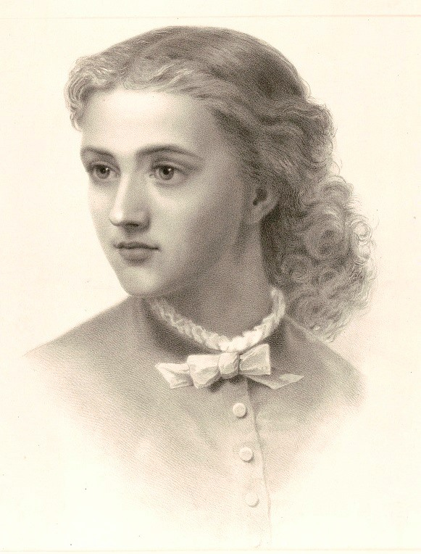
Maria Josepha Zozoya (1822-1846)
Creole daughter of local family
Mexican women nurses both US and Mexican troops
Considered fearless by both sides
Killed during battle while tending to wounded US soldier
US troops bury her with
Military honours and
compose song in her honour
“Maid of Monterey”

Slide 53
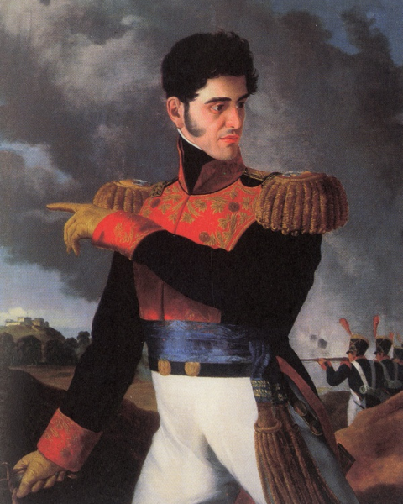
Santa Ana….again
Exiled from Mexico after defeating Spanish return in 1839…living In Cuba
Promises Americans he will
Persuade government to
agree peace…in exchange
For £2m todays money
Returns to Mexico, pockets
Cash…takes control of
Army..(again) and government
Assembles army of 15,000
to stop American invasion from
north

Slide 54
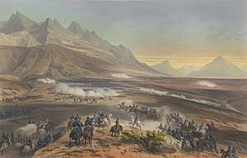
Battle of Buena Vista
Santa Anna army
Of 15,000 attack
5,000 Americans
Battle of Buena Vista Feb 22-23 1847
600 Americans 2,000
Mexicans casualties
Drawn.
Both sides claim
Victory. US advance
Stopped..Santa Ana
Returns to Mexico to
Crush Catholic revolt
Polk. Impatient
Orders seizer of Mexico
City…from coast

Slide 55
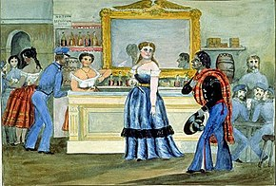
Sarah Bowman (1813-1866)
6ft 2’ Irish , 91KG ..Innkeeper, cook…known as “The Great Western”
Texas Ranger: “She could whip any man, fair fight or
foul, could shoot a pistol better than
anyone in the region, and at black jack
could outplay (or out cheat) the
slickest professional gambler.”
Quoted on being told battle lost” You
damned son of a bitch, there ain't
Mexicans enough in Mexico to whip old
Taylor. You just spread that report
and I'll beat you to death."[5]
Runs brothel after war…dies of spider
bite…given full military honours

Slide 56
Invasion East

Slide 57
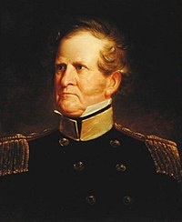
Winfred Scott (1786-1866)
Career soldier, Virginia family
War hero during War of 1812,Indian Wars
“Fuss and Feathers” famous for attending
needs & health of men.. Humane treatment
of Cherokee during Indian Removal
….attacked by Georgia for kindness
Meticulous planner with ability To choose & mentor excellent subordinates Robert E Lee, Ulysses Grant,
Intolerant of poor discipline, desertion.

Slide 58
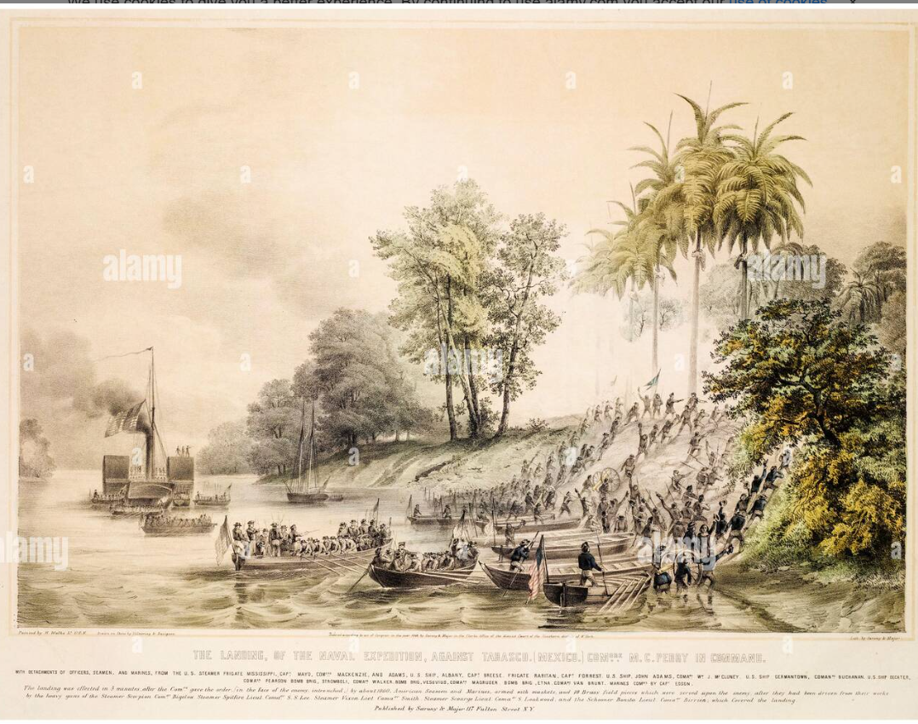
US Army landing at Vera Cruz
US army of 12,000
amphibious landing
March 1847
Scott leads inland
Following route Of Cortes
Santa Anna opposes
….unable to form mass army …multiple battles
….Americans victorious
US captures 100
..Irish Catholic members
Of Mexican “St Patricks
Battalion". Deserters

Slide 59
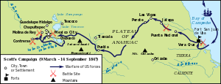
Advance on Mexico City ( March-September 1847

Slide 60
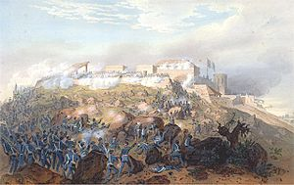
Battle of Chapultepec September 1847
Luxury Mansion …
Outskirts of Mexico City
Artillery led by Robert E
Lee breaches wall
& US troops storm
‘castle”. Ulysses Grant
reassembles cannons
.awarded medal
“Los Nino’s Heroes” …6 X 13-19 old Mexican army cadets.. Last survivor wraps
Mexican flag around him ..leaps from wall

Slide 61
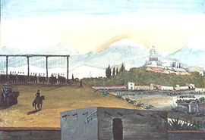
Saint Patricks Battalion
Irish Catholic arrive
In U.S 1846…lured into
US army on arrival
Persecuted by Protestants
….Mexican Agents approach during Northern campaign …’join us’ vs Protestants
Many captured during
Advance to Mexico
Gallows set up below Chaplet
Castle …50 Irish forced to watch
Attack from gallows
Scott orders them to be hanged
when US flag raised on castle

Slide 62
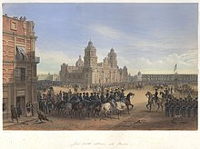
Occupation of Mexico City
Mexican government
Abandon City and US troops
occupy
Guerrilla war September 1846
Feb 1847
Polk sends Nicholas Twist
To secure peace…US wants
Greater Texas, California,
New Mexico…pay $15m
compensation

Slide 63
Treaty of San Guadalupe 1848
“All Mexico” movement…excitement to annex all Mexico & Central America
Polk sends message to Twist to annex all / most of Mexico
Alliance anti war Whigs (JQ Adams, Clay, A Lincoln” ….and South John C Calhoun “We have never dreamt of incorporating into our Union any but the Caucasian race—the free white race. To incorporate Mexico, would be the first instance of the kind of incorporating an Indian race; for more than half of the Mexicans are Indians, and the other is composed chiefly of mixed tribes. I protest against such a union as that! Ours, sir, is the Government of a white race.
Ambassador Twist ignores Polk message…..signs Treaty with new Mexican Government
…February 1848…(Santa Anno exiled…3rd time)
US gets all “New Spain”…….Mexico gets $100 million (2024 money)
…80,000 Mexicans living in New Spain ‘guaranteed’ citizenship & property rights….

Slide 64
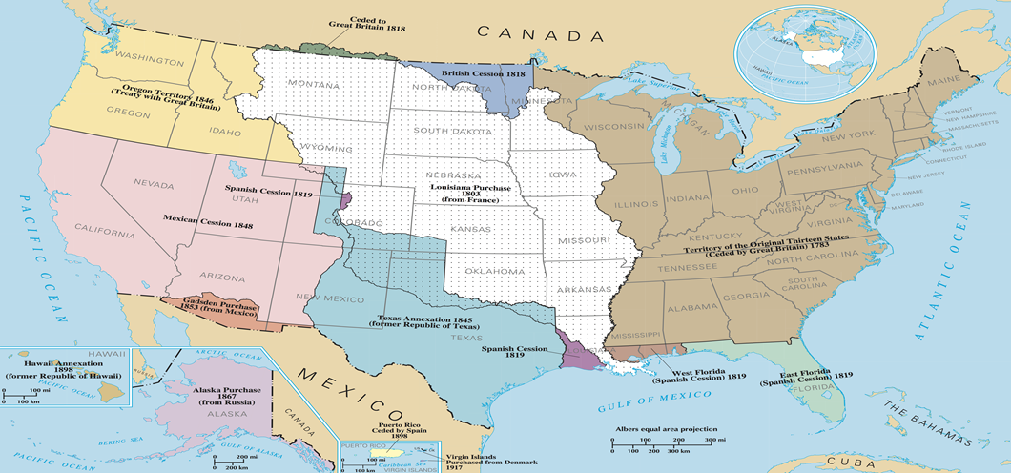
Continental Empire Complete

Slide 65
Mexican war aftermath
20,000 US and 30,000 Mexican Deaths..20% of armies 80% by disease
Manifest Destiny realised, myth of US military invincibility born
Not all think this way: Ulysses S Grant “ to this day I regard the war [with Mexico] ……as one of the most unjust ever waged by a stronger against a weaker nation. It was an instance of a republic following the bad example of European monarchies, in not considering justice in their desire to acquire additional territory.[
Debate whether new territory Free or Slave intensifies
Interesting news from California summer 1848

Slide 66
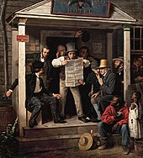
Gold
Lots of it!
Accessible!
Free for taking!
Come and Get it!

Slide 67
How that happened and what it meant the subject of next talk on Monday February 19th
News spreads around the world and hundreds of thousands head for California

